Slide 1
DESCRIPTION MY APP

Slide 2
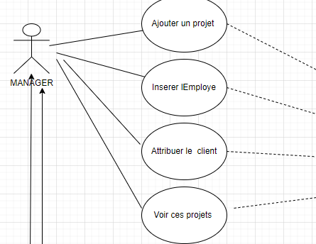
1 st ROLE

Slide 3
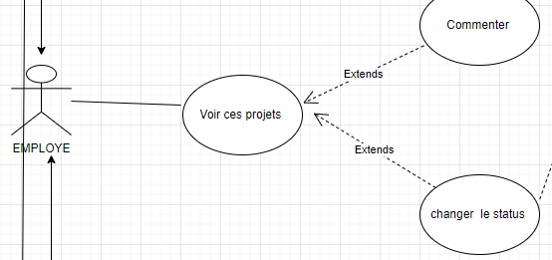
2 nd ROLE

Slide 4
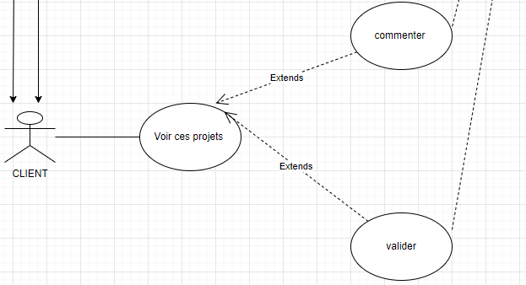
3 rd ROLE

Slide 5
